Slide 1

SFWRENG 4HC3 6HC3 /COMPSCI 4HC3 Human Computer Interfaces Lab 3: Design Thinking – Fitts’ Law
SFWRENG 4HC3 6HC3 | COMPSCI 4HC3 Danny Papagiannis
Acknowledgement: Parts of these lectures are based on material prepared by Andrew Maxwell, IDEO, Chris Collins and open source material from the Internet

Slide 2
WELCOME BACK!!

Slide 3

Design Theme: Safety on Campus
https://ugdsbisp.com/wp-content/uploads/2017/01/McMaster-University.jpg
https://ugdsbisp.com/wp-content/uploads/2017/01/McMaster-University.jpg

Slide 4
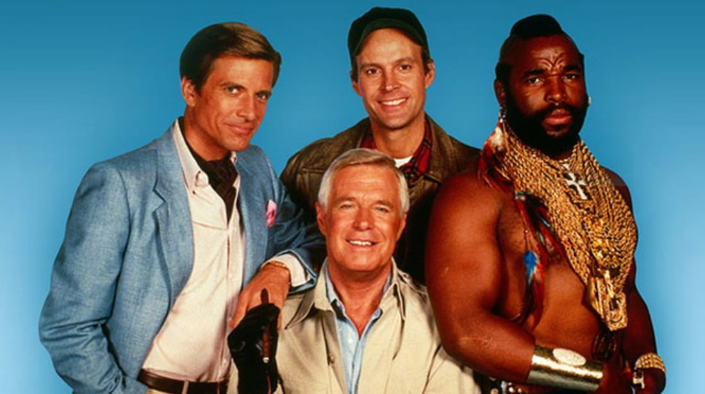
Problem Solving With The A-Team
https://images2.minutemediacdn.com/image/upload/c_crop,h_358,w_640,x_0,y_12/f_auto,q_auto,w_1100/v1555924029/shape/mentalfloss/a-team_1.jpg

Slide 5
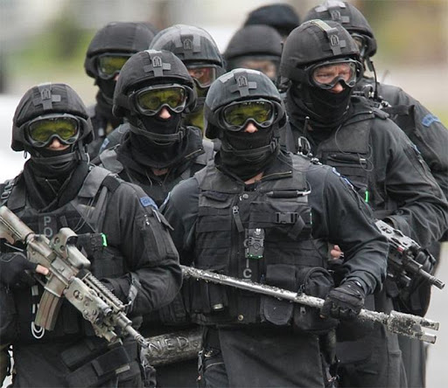
Case Study 2: Problem Solving With The Real A-Team
http://trueblueline.net/wp-content/uploads/2015/08/special-ops-groups.jpg

Slide 6
Case Study 2: SOG’s
3 convicts escaped from a maximum security prison in Australia
The team separated, 2 of them were caught
The outstanding convict has a criminal history of assault, robbery, weapons offences

Slide 7
Case Study 2: SOG’s
You have credible information that he is staying in a 3-storey hotel in a small town in Tasmania, possibly room 103
Strong possibility that he has weapons, and is willing to use them, possibly take hostages
There are about half a dozen people staying in the hotel

Slide 8


Slide 9
Case Study 2: SOG’s
You are a 5 member Special Operations Group (SOG) team
What do you do?
Breakout Session: 10 mins

Slide 11


Slide 12
Case Study SOG: Analysis
Solution: A SOG officer asked the Pizza delivery man where they were delivering to, and he answered 103
The officer noticed that the delivery man was wearing a uniform
The officer changed into his uniform and delivered the pizza
When he delivered the pizza, the convict opened the door
The officer took out his firearm and arrested the convict

Slide 13
Lab 3 Fitts’ Law Experiment

Slide 14

Fitt’s Law
$$MT=a+b\log_{2}{(\frac{A}{W}+1)}$$
Movement time
Speed of the device
(Slope)
Amplitude
Reaction time
(Intercept)
Width
Index of Difficulty
(ID)
Notes:
Thus, the units for b are time/bit; e.g., ms/bit. The constant a can be thought of as incorporating reaction time and/or the time required to click a button.
The values for a and b change as the conditions under which pointing is done are changed. For example, a mouse and stylus may both be used for pointing, but have different constants a and b associated with them.

Slide 15
Fitts’ Law
Thus, the units for b are time/bit; e.g., ms/bit. The constant a can be thought of as incorporating reaction time and/or the time required to click a button.
The values for a and b change as the conditions under which pointing is done are changed. For example, a mouse and stylus may both be used for pointing, but have different constants a and b associated with them.

Slide 16

Experiment Design
Each experimental condition is determined by:
Amplitude (A)
Width (W)
Record:
Average Movement Time (MT)
$$\frac{A}{W}$$
Notes:
http://www.tele-actor.net/fitts/index.html

Slide 17
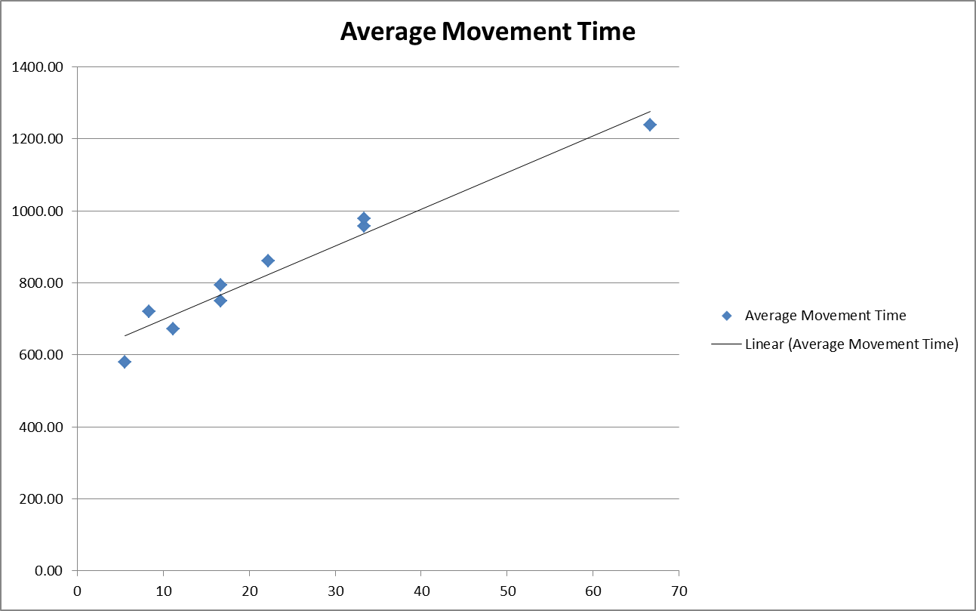
Results
Ratio A/W

Slide 18
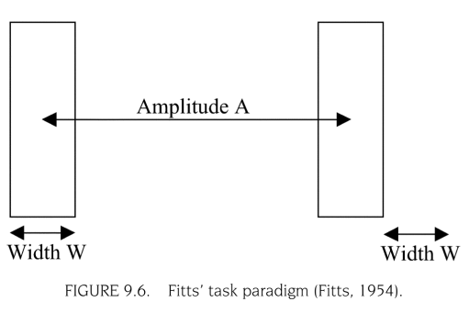
Fitt’s Law
Notes:
Fitts's law (often cited as Fitts' law) is a model of human movement, Fitts's law is used to model the act of pointing
For a input particular device it gives you the time needed to acquire a target with a width W from a distance A.

Slide 19
Follow the link to try the experiment
http://ergo.human.cornell.edu/FittsLaw/FittsLaw.html

